Slide 1
8-19-22 Simulink Tests

Slide 2
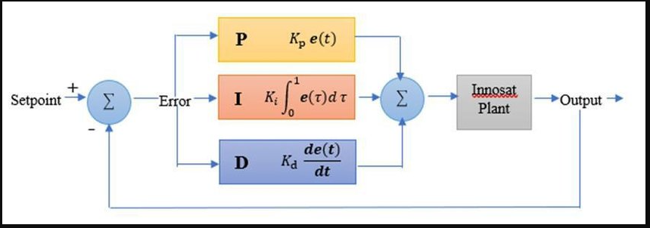
Attitude PID Control (Simulink AutoTune)
Block diagram shown below (slight changes, created attitudeControl subsystem. It was a basic feedback loop).

Slide 3
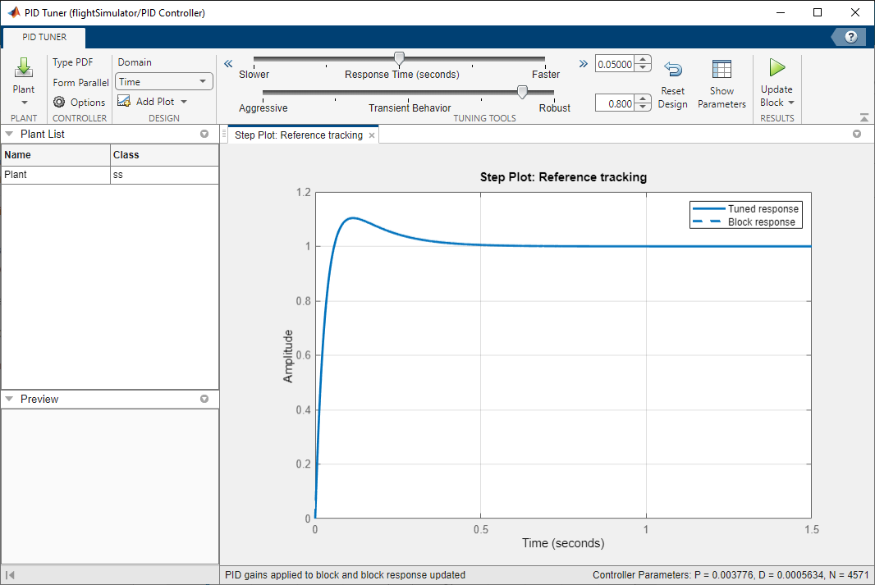
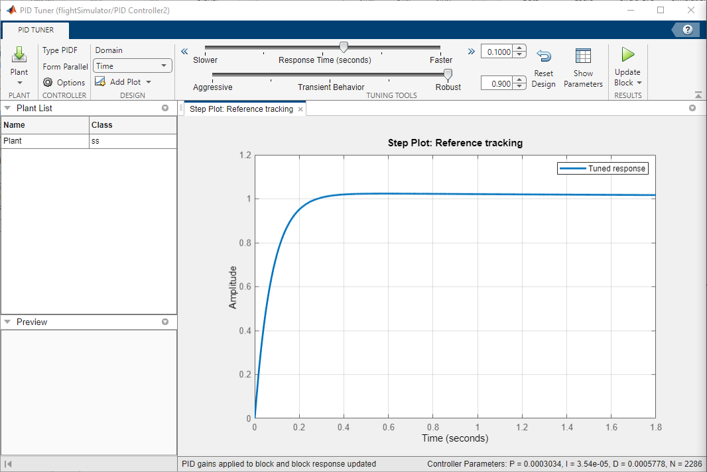
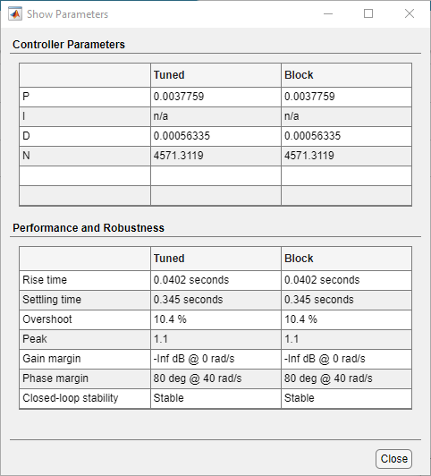
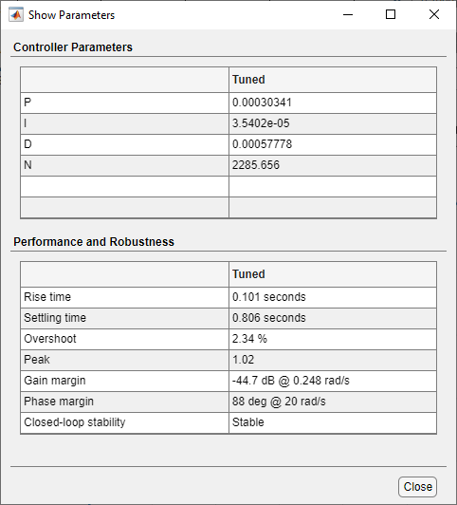
Attitude PID control (Simulink Plant Response)
Roll/Pitch
Yaw

Slide 4
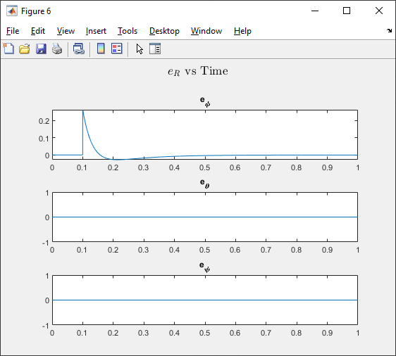
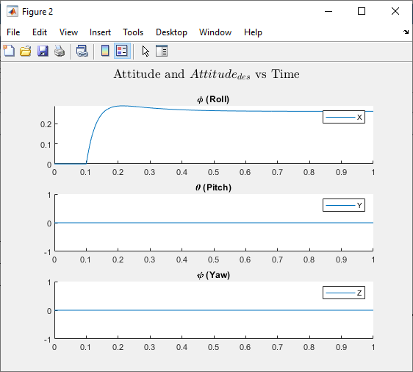
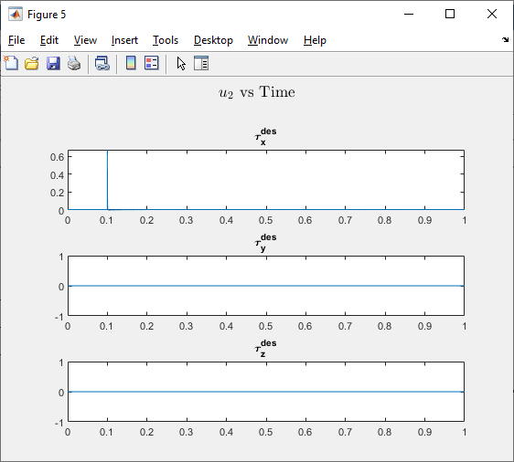

Results from step impulse at 0.1 s of 15 deg (~.26 rad) in $ϕ$ angle

Slide 5

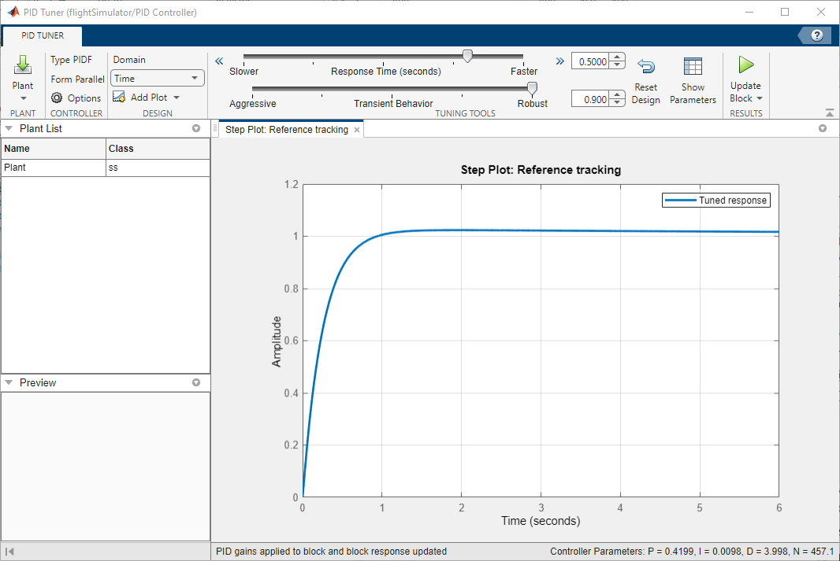
Thrust Control (u1)
Thrust Control (u1 tuning)

